Slide 1
Angular Upskilling Program
Angular Router

Slide 2
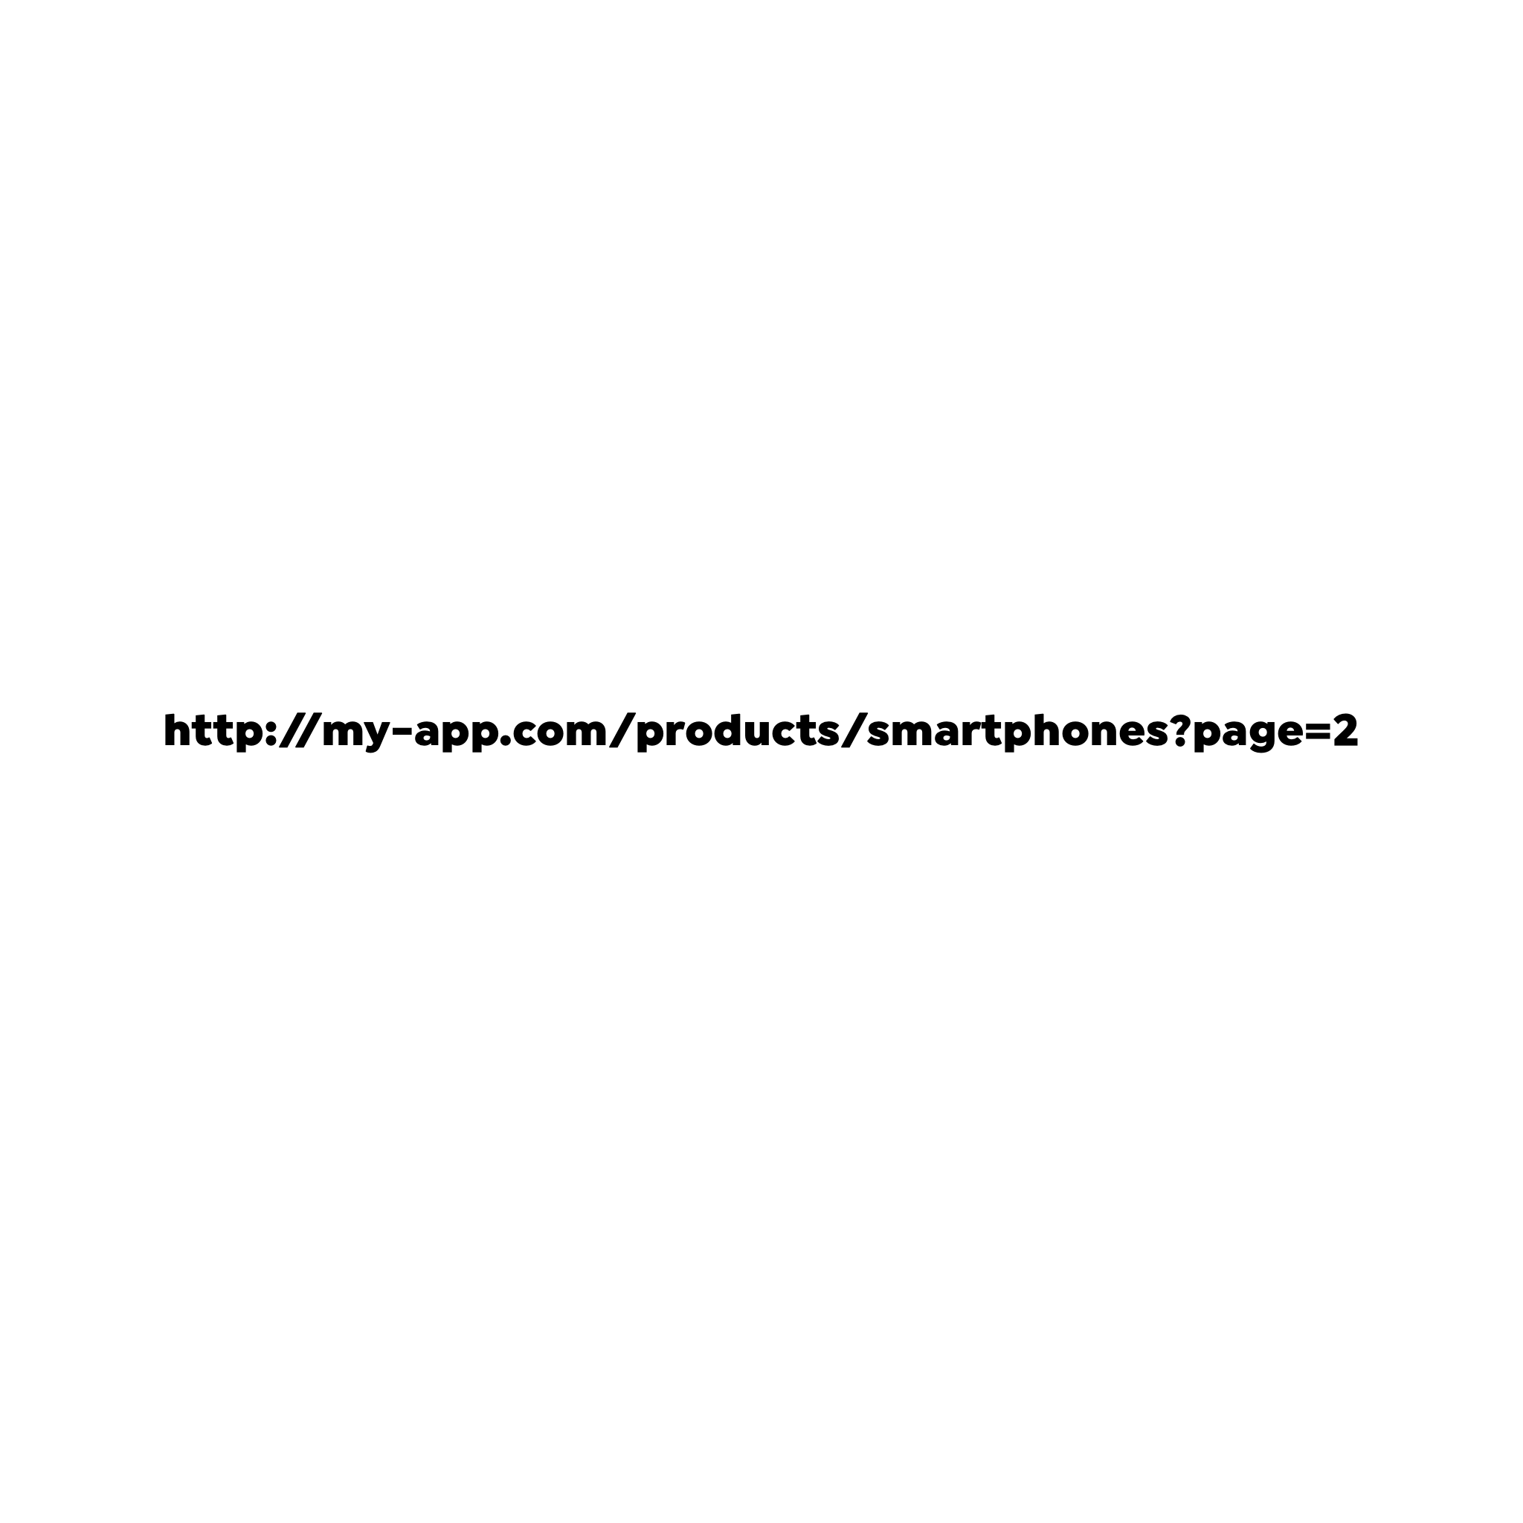
Angular Router
Router is needed in order to share a web application state to another user.
If a routing mechanism wouldn’t be present on the application, sharing
the URL to another client would cause undefined behaviour.
When the URL is accessed the application needs to know what products, smartphone and
page=2 means.
In this case:
products might be the path used for loading the ProductsComponent;
smartphones could be some filtering mechanism by using the path parameter;
page=2 could tell the number of the page from the products list to be loaded.

Slide 3
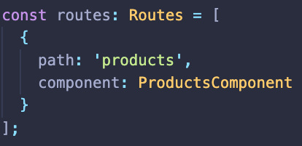
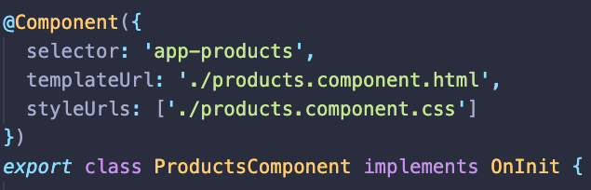
How Angular Router works?
Analyzes the URL entered in the browser: https://my-app.com/products
Looks for a router configuration for that specific path:
Instantiate the component mentioned in the configuration
Renders the component’s template in router’s content container.

Slide 4
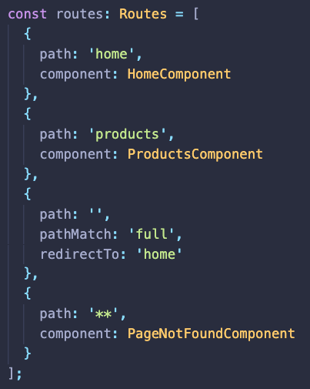
Angular Router - Configuration
Router’s path configuration should be setup in a constant variable of type Routes (Route[]), where each route is defined with a path and component.
‘**’ path is used as a wild card for an URL that is not matching any path from the configuration.
This configuration is passed to the RouterModule by using the forRoot method.
To avoid

Slide 5


